Slide 1


Business Problem 8 – Laundry pick-up start-up
Powered by Stay Ahead
We Build Network!!!

Slide 2

Business Problem
You are a Data Scientist working for a laundry-pickup services startup. This is a relatively small company and they cannot compete with the big players in the major cities. The company's strategy is to build a vast network in the smaller cities.
This company already had a strong presence in 140 locations and recently opened stores in 10 new cities. Additionally, the company has two separate sales region.
You have been assigned two analytics tasks
Identify which of the two sales regions is performing better (Outperforms the other in 2 of the 3 metrics)
AVG Revenue per city
AVG Marketing spend per city (Less is better)
AVG ROMI per city (Revenue/Marketing spend)
Identify which of the 10 new locations have the best potential for the company to invest more funds into marketing
What we will learn today
New Features in Tableau 10
Custom Territory
Groups
Geocoding
Highlighting
Cross database joining
Clustering
Saving a cluster
Device type dashboards

Slide 3
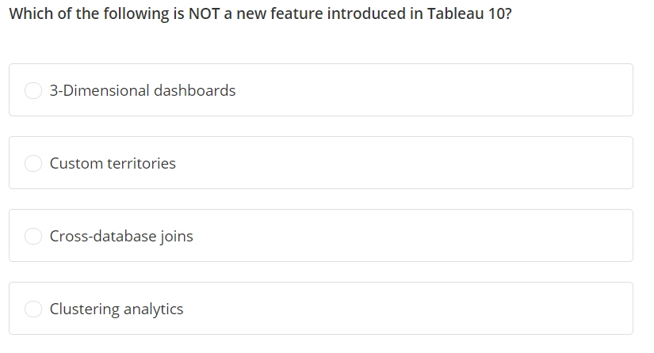

Slide 4
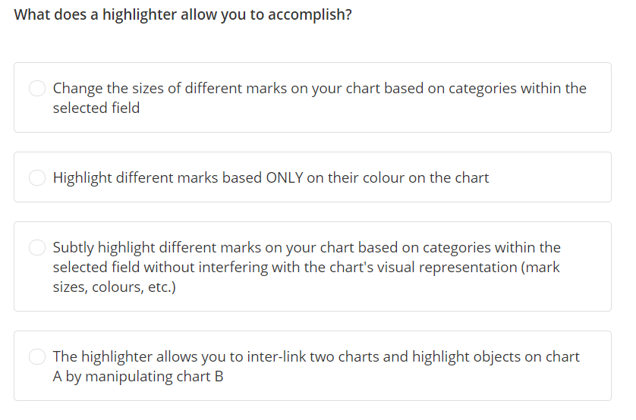

Slide 5
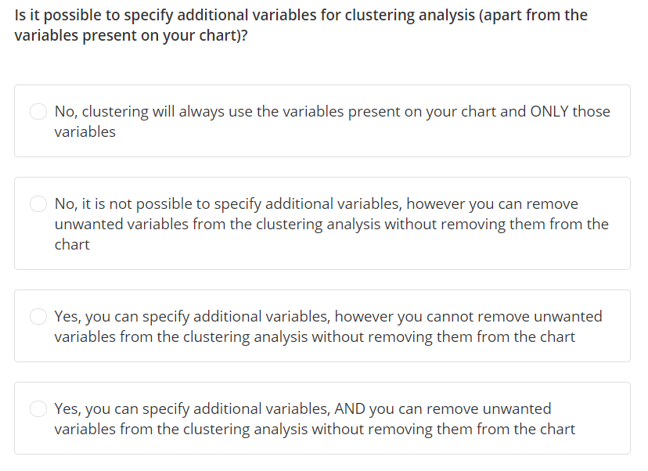

Slide 6
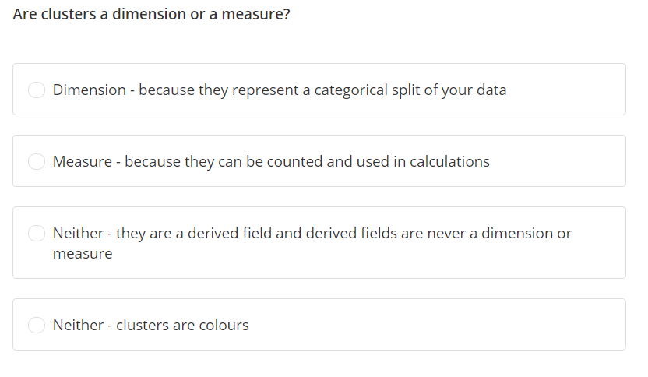

Slide 7
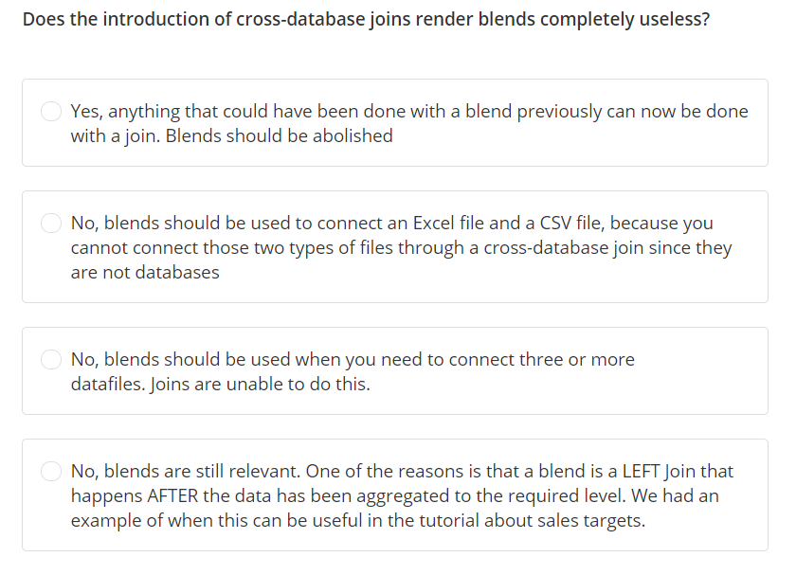

Slide 8
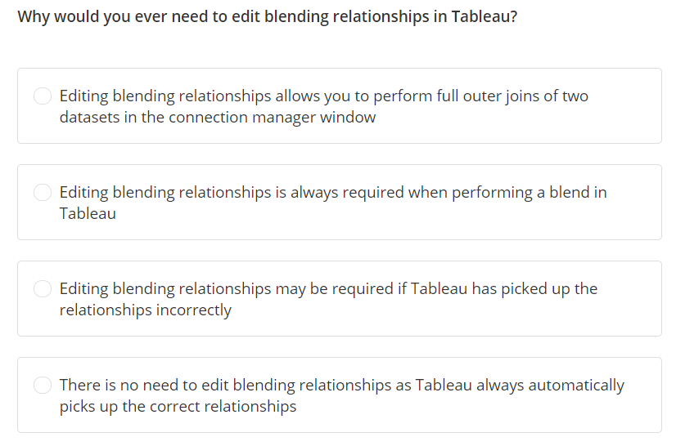

Slide 9
Business Problem 9 – World bank group
Powered by Stay Ahead
We Build Network!!!

Slide 10

Business Problem
You have been hired by the World Bank as a Tableau Developer.
Your first assignment is to deliver an animated dashboard showing how populations of countries across the World have been developing over the past 50 years.
Specifically, the stakeholders of this assignment are interested to see overall trends in fertility, life expectancy and population. In addition to overall trends they would like to be able to drill into individual countries.
What we will learn today
Adding Animations in the visualization
Different options in Animation
Sorting by the field on secondary data
https://www.ted.com/talks/hans_rosling_shows_the_best_stats_you_ve_ever_seen

Slide 11
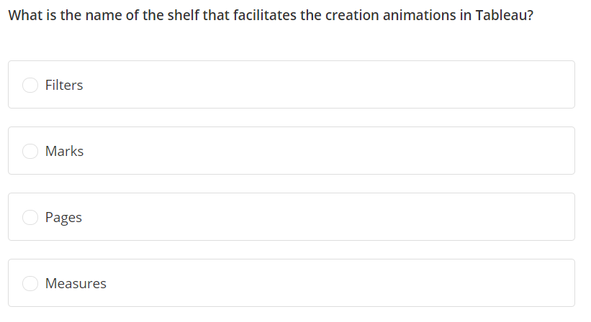

Slide 12
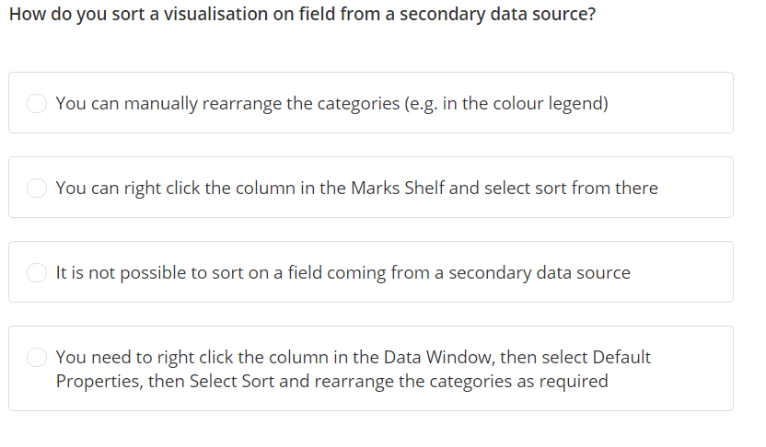

Slide 13

Easy Questions:
1. What is Tableau? Or Why Data Visualization with Tableau?
2. How is Tableau better than other products?
3. Name 1 advantage and 1 disadvantage of using Tableau extracts
4. What is a treemap and what are the building elements of a treemap?
5. How do you enable a dual axis on a chart?
6. Is there a free version of Tableau? If so, what are its main limitations?
7. What is the difference between CSV and Excel files?
8. How do you change a quick filter from a list of items to a dropdown?
Medium Questions:
1. If a field is not in your view, can you use it as a filter for the view?
2. How do you change level of detail without adding to the visualization?
3. Tableau Desktop and Tableau Server limitations question
4. What is the difference between twb and twbx files?
5. What are blended axes in Tableau and how do you create them?
6. When can you delete worksheets and when can you only hide them?
7. How do you make animations leave a trail?
8. How do you run a simple linear regression statistical model in Tableau?
9. How does aggregation work in Tableau?
10. Is a blend in Tableau a type of join? If so, then which type?
Difficult Questions:
1. What are filters? How many types of filters are there in Tableau?
2. Give an example of a use-case for Data Source filters
3. Everything about context filters!
4. What is the difference between joins and blends in Tableau?
5. How do Blends work in Tableau?
6. How do you combine Data through appending?
7. How do you combine Data through a custom SQL query?
8. What is the difference between static and dynamic sets?
9. What roles do dimensions and measures play in Tableau?
10. What is the difference between discrete and continuous variables in Tableau?
Interview Questions

